Slide 1

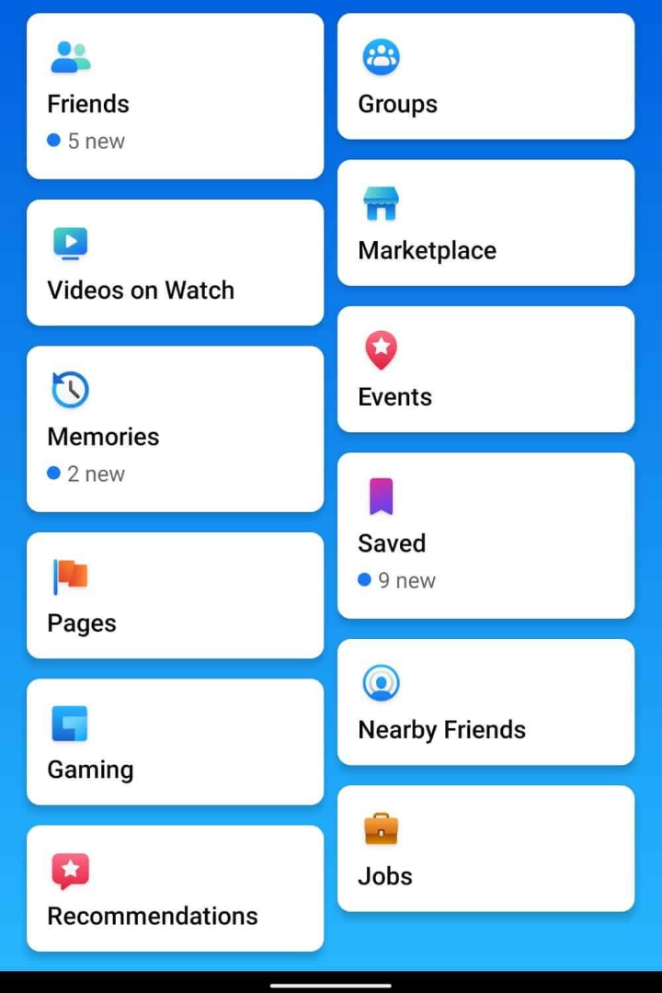

Interfaced Designe.
An interface is the front-end application view to which user interacts with the software. It determines how commands are given to the computer and how data is displayed on the screen.
Interface design is the process of creating a user-friendly and intuitive interface for software, websites, or applications. It involves designing the layout, navigation, and visual elements to ensure a seamless user experience.
The software becomes more popular if its user interface is:
Attractive
Simple to use
Responsive in short time
Clear to understand
Consistent on all interfacing

Slide 2
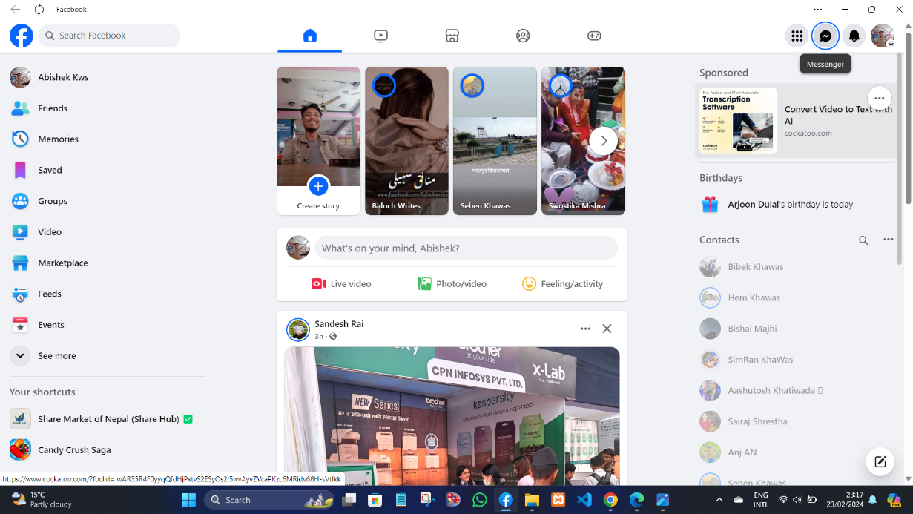

Slide 3
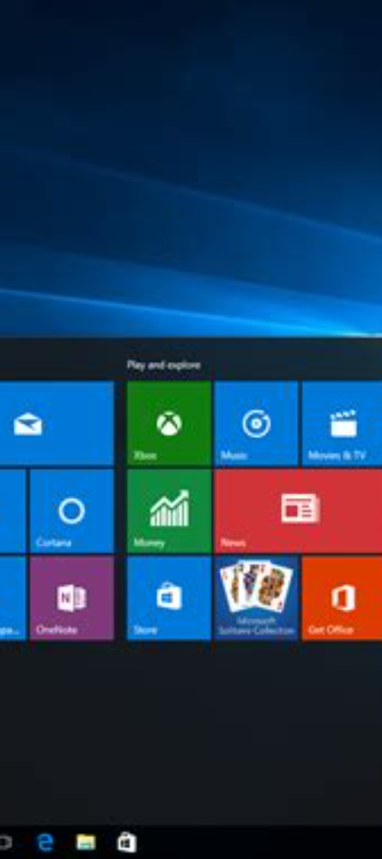
Importance of Interfaced Design
1
Enhances Usability
2
Boosts Engagement
Improved user experience through intuitive and efficient interfaces.
Attracts and retains users with visually appealing interfaces.
3
Increases Adoption
Easy-to-use interfaces lead to higher user adoption rates.

Slide 4




Benefits of Implementing Interfaced Design
Enhanced User Experience
Improved satisfaction and interaction for users.
Increased Efficiency
Streamlined processes and faster task completion.
Competitive Advantage
Stand out with compelling and innovative interfaces.

